Slide 1
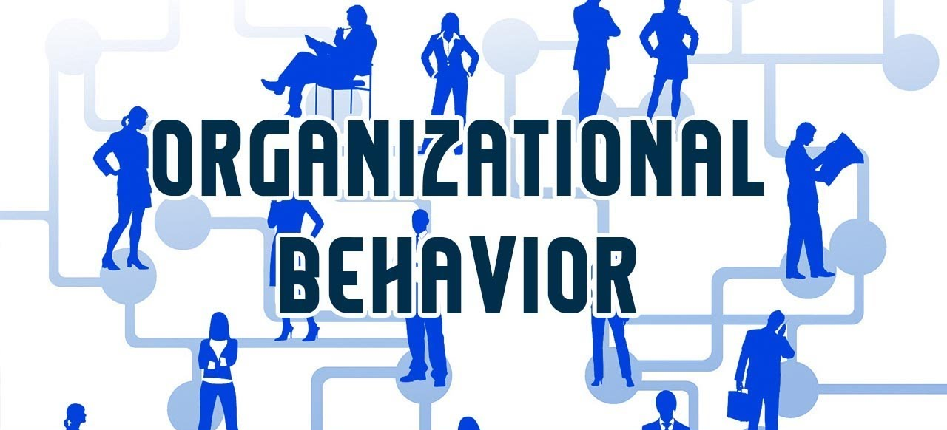


Perception and Individual Decision Making
Instructor: Dr. Muhammad Rafiq
Chapter 6: Organizational Behavior – 15th Edition

Slide 2

COUNT THE NUMBER OF F'S IN THE BOX
FINISHED FILES ARE RESULT OF YEARS OF SCIENTIFIC STUDY COMBINED WITH THE EXPERIENCE OF MANY YEARS
Notes:
Amazing Illusion, isn't it? Most people count three of them, so much for perception, but it does not say anything about your IQ. Whoever counts the six 'F' the first time is a genius, four is rather frequent, five is rather rare, three is normal. Less than three, and you must change glasses ; -) For some obscure resaons, we (or our brain) do not count the "f" in "of", maybe because the phonetic is similar to "ov", or because during (quick) reading the brain focus on "lexical" words, and not so much on "grammatical" words.

Slide 3
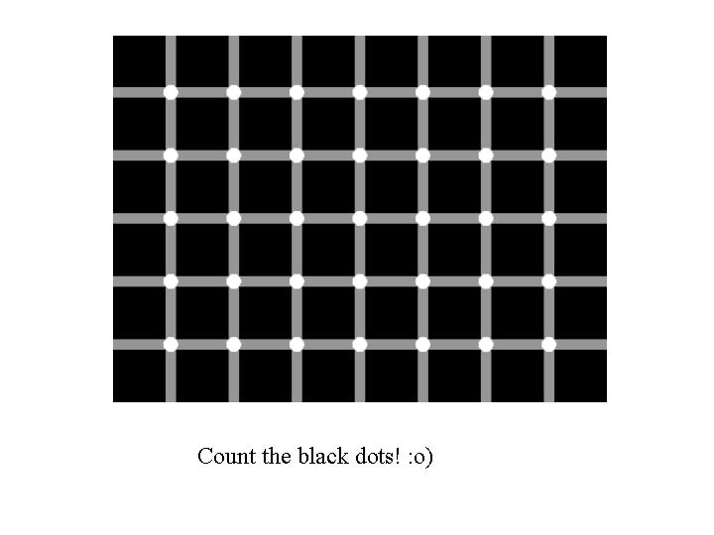
Notes:
Look carefully at this image and count the black dots that you can see on the grid. You will notice that when you focus on a single dot, it turns white. The black dots appear around your area of focus, not within it. This is because the brain is affected by the dominance of the black squares and thinks that the dots must be negative. In fact, none of the dots are black, they are all white. This optical illusion is used sometimes in schools, to see how effectively children cope with focus and concentration skills in a learning environment.

Slide 4
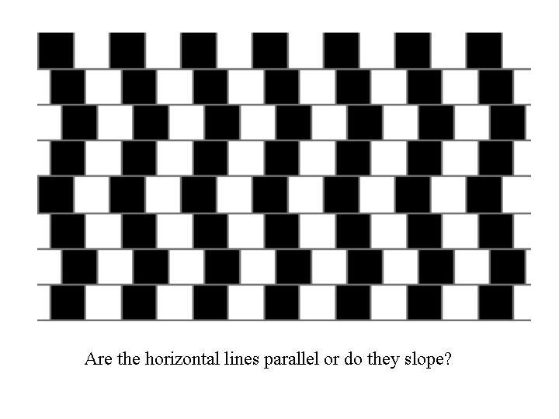
Notes:
Are the horizontal lines in this image parallel or do they slope down? This is a popular, simple optical illusion that uses black and white effectively to confuse our perceptions of what we are seeing. Because we are trying to rationalise either the black vertical lines or white vertical lines, we cannot make sense of the untidiness of the columns and, to our eyes, the horizontal lines are sloping downwards. Our eyes naturally follow the powerful vertical lines. In fact, the horizontal lines themselves are perfectly straight and measuring them would prove that they do not slope down at all.

Slide 5
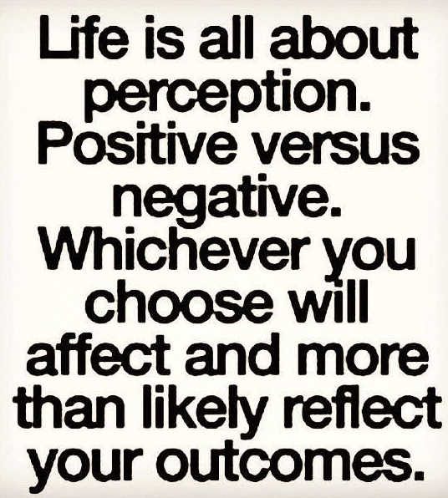
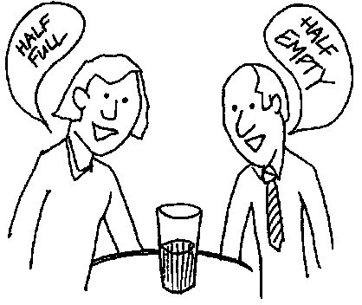
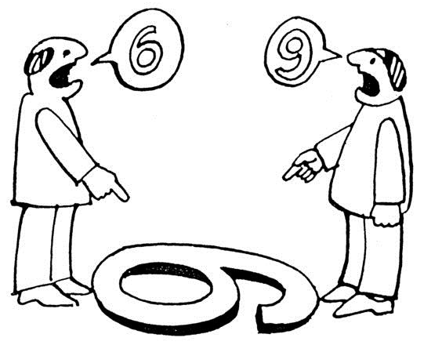
What Is Perception?
Perception
A process by which individuals organize and interpret their sensory impressions in order to give meaning to their environment.
OR
The process of integrating, organizing, and interpreting sensory information.
People’s behavior is based on their perception of what reality is, not on reality itself.
Notes:
“ The study of perception is concerned with identifying the process through which we interpret and organize sensory information to produce our conscious experience of objects and object relationship.”
Perception is an intellectual process of transforming sensory stimuli to meaningful information. It is the process of interpreting something that we see or hear in our mind and use it later to judge and give a verdict on a situation, person, group etc.
It can be divided into six types −
Of sound − The ability to receive sound by identifying vibrations.
Of speech − The competence of interpreting and understanding the sounds of language heard.
Touch − Identifying objects through patterns of its surface by touching it.
Taste − The ability to receive flavor of substances by tasting it through sensory organs known as taste buds.
Other senses − They approve perception through body, like balance, acceleration, pain, time, sensation felt in throat and lungs etc.
Of the social world − It permits people to understand other individuals and groups of their social world. Example − Yasir goes to a restaurant and likes their customer service, so he will perceive that it is a good place to hang out and will recommend it to his friends, who may or may not like it. Yasir’s perception about the restaurant is good.
Importance of Perception in OB
We need to understand what the role of perception in an organization is. It is very important in establishing different role of perceptions like −
Understanding the tasks to be performed.
Understanding associated importance of tasks allotted.
Understanding preferred behavior to complete respective tasks.
Clarifying role perceptions.
For example, every member in a group has to be clear regarding the role allotted to them. Programmer writes the code, tester checks it, etc.

Slide 6
Importance of Perception
Perception is important in understanding variations in individual behavior.
Every individual perceives the environment differently and therefore, understanding the perception help us find out why every individual behaves in a particular manner.
This is one of the major reason why one individual finds one job interesting and satisfying while another finds the same job boring and dissatisfying.
Notes:
“ The study of perception is concerned with identifying the process through which we interpret and organize sensory information to produce our conscious experience of objects and object relationship.”
Perception is an intellectual process of transforming sensory stimuli to meaningful information. It is the process of interpreting something that we see or hear in our mind and use it later to judge and give a verdict on a situation, person, group etc.
It can be divided into six types −
Of sound − The ability to receive sound by identifying vibrations.
Of speech − The competence of interpreting and understanding the sounds of language heard.
Touch − Identifying objects through patterns of its surface by touching it.
Taste − The ability to receive flavor of substances by tasting it through sensory organs known as taste buds.
Other senses − They approve perception through body, like balance, acceleration, pain, time, sensation felt in throat and lungs etc.
Of the social world − It permits people to understand other individuals and groups of their social world. Example − Yasir goes to a restaurant and likes their customer service, so he will perceive that it is a good place to hang out and will recommend it to his friends, who may or may not like it. Yasir’s perception about the restaurant is good.
Importance of Perception in OB
We need to understand what the role of perception in an organization is. It is very important in establishing different role of perceptions like −
Understanding the tasks to be performed.
Understanding associated importance of tasks allotted.
Understanding preferred behavior to complete respective tasks.
Clarifying role perceptions.
For example, every member in a group has to be clear regarding the role allotted to them. Programmer writes the code, tester checks it, etc.

Slide 7
How do we take in information?
Perceptual Process:
Perceptual process are the different stages of perception we go through. The different stages are:
Receiving
Selecting
Organizing
Interpreting
Exposure
External Stimuli
Sensory Receptors
Perception
Sights
Eyes
Sounds
Ears
Attention
Smells
Nose
Tastes
Tongue
Touch/Movement
Heat, pressure, & motor receptors
Notes:
Receiving is the first and most important stage in the process of perception. It is the initial stage in which a person collects all information and receives the information through the sense organs.
Selecting is the second stage in the process. Here a person doesn’t receive the data randomly but selectively. A person selects some information out of all in accordance with his interest or needs. The selection of data is dominated by various external and internal factors.
External factors − The factors that influence the perception of an individual externally are intensity, size, contrast, movement, repetition, familiarity, and novelty.
Internal factors − The factors that influence the perception of an individual internally are psychological requirements, learning, background, experience, self-acceptance, and interest.
Organizing
Keeping things in order or say in a synchronized way is organizing. In order to make sense of the data received, it is important to organize them.
We can organize the data by −
Grouping them on the basis of their similarity, proximity, closure, continuity.
Establishing a figure ground is the basic process in perception. Here by figure we mean what is kept as main focus and by ground we mean background stimuli, which are not given attention.
Perceptual constancy that is the tendency to stabilize perception so that contextual changes don’t affect them.
Interpreting
Finally, we have the process of interpreting which means forming an idea about a particular object depending upon the need or interest. Interpretation means that the information we have sensed and organized, is finally given a meaning by turning it into something that can be categorized. It includes stereotyping, halo effect etc.
Sensation:
The immediate response of our sensory receptors to basic stimuli such as light, color, sound, scent, touch, taste…
Sensation is physical
Perception
The process by which sensations are selected and organized
Perception is what we add to raw sensations so that we can be interpreted
Perception is psychological
It’s active
It’s relative

Slide 8
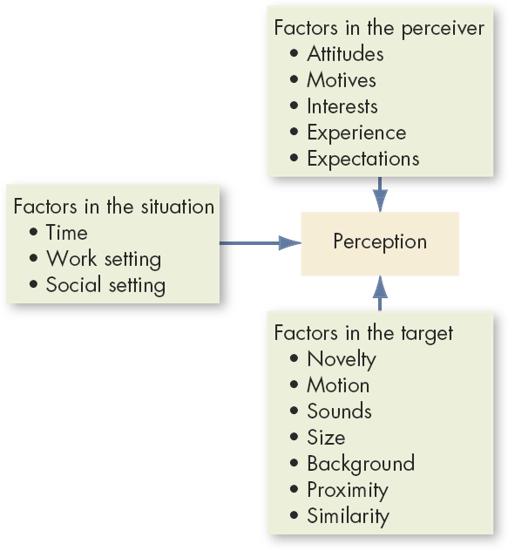
Factors That Influence Perception
Perceiver (Your interpretation is influenced by your personal characteristics)
Target (The relationship of a target to its background also influences perception)
Situation (The time, location, heat, light, and other situational factors influence our attention).
Notes:
External factors − The factors that influence the perception of an individual externally are intensity, size, contrast, movement, repetition, familiarity, and novelty.
Internal factors − The factors that influence the perception of an individual internally are psychological requirements, learning, background, experience, self-acceptance, and interest.

Slide 9
Person Perception: Making Judgments About Others
Attribution Theory:
When individuals observe behavior, they attempt to determine whether it is internally or externally caused.
Distinctiveness: shows different behaviors in different situations.
Consensus: response is the same as others to same situation.
Consistency: responds in the same way over time.
Notes:
How do we attach meaning to other's behavior or our own? This is called attribution theory. For example, is someone angry because they are bad-tempered or because something bad happened.
Attribution theory is concerned with how and why ordinary people explain events as they do.
Heider (1958) believed that people are naive psychologists trying to make sense of the social world. People tend to see cause and effect relationships, even where there is none!. Heider didn’t so much develop a theory himself as emphasize certain themes that others took up. There were two main ideas that he put forward that became influential.
1. Internal Attribution
The process of assigning the cause of behavior to some internal characteristic, rather than to outside forces. When we explain the behavior of others we look for enduring internal attributions, such as personality traits.
For example, we attribute the behavior of a person to their personality, motives or beliefs.
2. External Attribution
The process of assigning the cause of behavior to some situation or event outside a person's control rather than to some internal characteristic.
When we try to explain our own behavior we tend to make external attributions, such as situational or environment features.

Slide 10
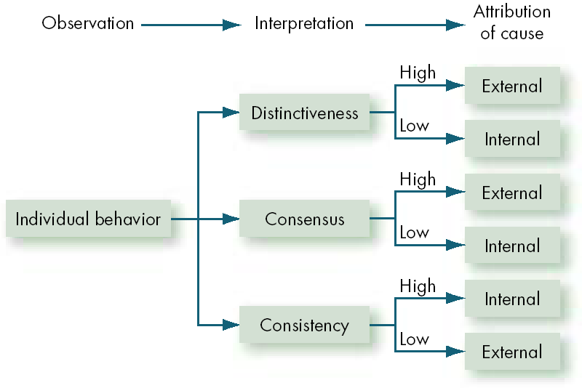
Attribution Theory
Notes:
1. Internal Attribution
The process of assigning the cause of behavior to some internal characteristic, rather than to outside forces. When we explain the behavior of others we look for enduring internal attributions, such as personality traits.
For example, we attribute the behavior of a person to their personality, motives or beliefs.
2. External Attribution
The process of assigning the cause of behavior to some situation or event outside a person's control rather than to some internal characteristic.
When we try to explain our own behavior we tend to make external attributions, such as situational or environment features.

Slide 11


Errors and Biases in Attributions
Fundamental Attribution Error
The tendency to underestimate the influence of external factors and overestimate the influence of internal factors when making judgments about the behavior of others.
In general, we tend to blame the person first, not the situation.

Slide 12
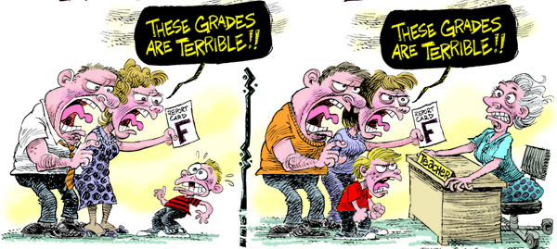
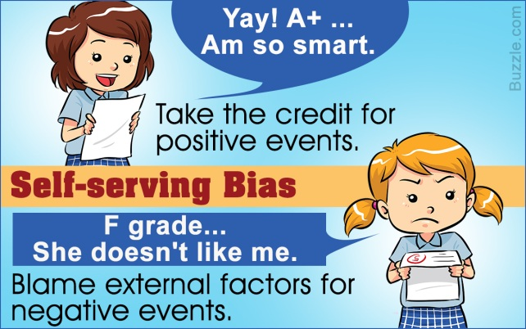
Errors and Biases in Attributions (cont’d)
Self-Serving Bias
The tendency for individuals to attribute their own successes to internal factors while putting the blame for failures on external factors.
Thought: When student gets an “A” in an exam, they often say they studied hard. But when they don’t do well, how does the self serving bias come into play?
Hint: Whose fault is it usually when an exam is “tough”?

Slide 13
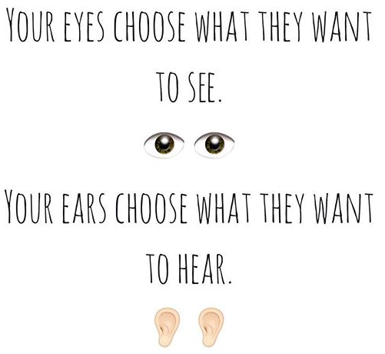
Frequently Used Shortcuts in Judging Others
Selective Perception
People selectively interpret what they see on the basis of their interests, values, background, experience, and attitudes.
This means that:
The perception is different from one person to another.
The information received will be interpreted differently from one person to another.

Slide 14
Frequently Used Shortcuts in Judging Others
Halo Effect
Contrast Effects
Drawing a general impression about an individual on the basis of a single characteristic
Evaluation of a person’s characteristics that are affected by comparisons with other people recently encountered who rank higher or lower on the same characteristics.
Notes:
This is a psychological prejudice where the impression of a person in any one area makes you believe that he/she is equally good in other areas.
This was first acknowledged and named by psychologist Edward Thorndike in1920 and in his research he observed people who are perceived to have a positive image in one area tend to be anticipated to have same positive talents and qualities in other areas.
A tall good looking man is mostly always perceived to be smarter than average - even if you have just met for the first time.
Anyone who just showed some good qualities at your office in one specific task is simply taken for granted that he/she will perform equally good at other tasks and will always be preferred to someone who is a bit quieter or shy.
In many cultures women or a colleague from a minority cluster is often perceived to be less intelligent, less accomplished and less skilled.
This is the “negative” Halo Effect, which imposes if you are (deceitfully) observed or stated to be less capable in any one area, you are then repeatedly and unfairly understood to be less skilled in other areas too.
If you have made a mistake at one point in one junction at your work, you are often perceived to be prone to mistakes in all areas of your work.

Slide 15
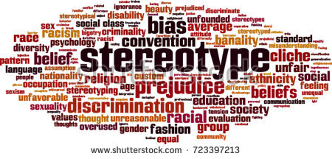
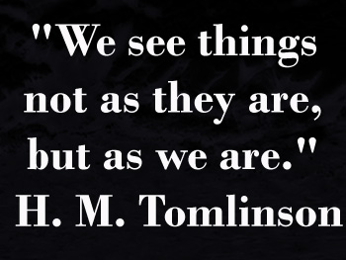
Frequently Used Shortcuts in Judging Others
Projection
Stereotyping
Attributing one’s own characteristics to other people.
People who engage in projection tend to perceive others according to what they themselves are like.
Judging someone on the basis of one’s perception of the group to which that person belongs.
Notes:
This is a psychological prejudice where the impression of a person in any one area makes you believe that he/she is equally good in other areas.
This was first acknowledged and named by psychologist Edward Thorndike in1920 and in his research he observed people who are perceived to have a positive image in one area tend to be anticipated to have same positive talents and qualities in other areas.
A tall good looking man is mostly always perceived to be smarter than average - even if you have just met for the first time.
Anyone who just showed some good qualities at your office in one specific task is simply taken for granted that he/she will perform equally good at other tasks and will always be preferred to someone who is a bit quieter or shy.
In many cultures women or a colleague from a minority cluster is often perceived to be less intelligent, less accomplished and less skilled.
This is the “negative” Halo Effect, which imposes if you are (deceitfully) observed or stated to be less capable in any one area, you are then repeatedly and unfairly understood to be less skilled in other areas too.
If you have made a mistake at one point in one junction at your work, you are often perceived to be prone to mistakes in all areas of your work.

Slide 16
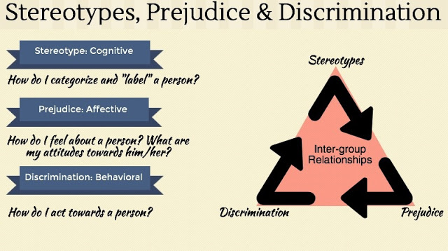


Stereotype is simply a widely held belief that an individual of certain group holds distinct characteristics.
Prejudice: An attitude (usually negative) shown towards individuals based on his/her religious, cultural, ethnic, political or other affiliation without having prior knowledge about the group.
Discrimination is the tendency to react against different stimuli in different ways.
Notes:
Prejudice:
An attitude (usually negative) shown towards individuals based on his/her religious, cultural, ethnic, political or other affiliation without having prior knowledge about the group. Such attitudes are based on assumptions far from objective reality. Prejudice has cognitive, affective, and behavioral components. Based on beliefs, it can affect one's emotions and behavior, sometimes leading to discrimination. Prejudiced beliefs primarily take the form of stereotypes, overall impressions based on the assumption that all members of a group possess similar attributes. Prejudices can both negative and positive.
Eg. Women are weak. (Negative)
Europeans are educated and intelligent. (Positive)
Stereotype:
Stereotype is defined as an “oversimplified, usually pejorative, attitude people hold towards those outside one’s own experience who are different. They are a result of incomplete or distorted information accepted as fact without question. A stereotype is simply a widely held belief that an individual of certain group holds distinct characteristics. Due to the process of overgeneralization within social perception, stereotyping leads to a great deal of inaccuracy in social perception. Sex, race, age, religion, sexual orientation and physical ability are various categories which exist in stereotyping. The most prevalent and controversial forms are sex and race.
When prejudice becomes a belief then it is termed as stereotype. Such belief may or may not be real. Prejudices are reproduced time and again due to conformity biases in individuals which embeds into the belief system. E.g. Muslims are stereotyped as terrorists.
Discrimination:
Discrimination is a behavioral aspect just opposite to generalization. In psychology discrimination is neither negative nor positive. Discrimination is the tendency to react against different stimuli in different ways. For example: if a person encounters a tiger in the wild, he/she tries to flee but the same person may not flee if he/she encounters a peacock.
However, if the discrimination is resulted by prejudice or stereotype then such discriminations are usually negative. Usually negative discriminations are studied in the social sciences. Eg. Racial discrimination, caste based discrimination, religious discrimination, gender discrimination etc.

Slide 17
Application of Perceptual Biases in Organizations
Employment Interview
Ethnic Profiling
Perceptual biases of raters affect the accuracy of interviewers’ judgments of applicants.
A form of stereotyping in which a group of individuals is singled out—typically on the basis of race or ethnicity—for intensive inquiry.
Performance Expectations
Performance Evaluation
Self-fulfilling prophecy (Pygmalion effect): The lower or higher performance of employees reflects preconceived leader expectations about employee capabilities.
Appraisals are often the subjective (judgmental) perceptions of appraisers of another employee’s job performance.
Notes:
Ethnic profiling is the use of racial, ethnic, national, or religious characteristics as a way of singling out people for identity or security checks.
Employment Interview
Perceptual biases of raters affect the accuracy of interviewers’ judgments of applicants.
Performance Expectations
Self-fulfilling prophecy (Pygmalion effect): The lower or higher performance of employees reflects preconceived leader expectations about employee capabilities.
Ethnic Profiling
A form of stereotyping in which a group of individuals is singled out—typically on the basis of race or ethnicity—for intensive inquiry, scrutinizing, or investigation.

Slide 18
The Link Between Perceptions and Individual Decision Making
Problem A perceived discrepancy between the current state of affairs and a desired state.
Decisions Choices made from alternatives developed from data perceived as relevant.
Perception of the decision maker
Outcomes

Slide 19
Rational Decision-Making Model
A decision-making model that describes how individuals should behave in order to maximize some outcome.
Assumptions are that, decision makers:
Are perfectly rational, fully objective, and logical.
Have carefully defined the problem and know the criteria for evaluating alternatives, select alternative with maximum benefit.
Will select the alternative that maximizes outcomes in the organization’s interests rather than in their personal interests.
Decision maker strives for information and certainty, alternatives evaluated.
Problem clarity, Known options, Clear preferences, Constant preferences, No time or cost constraints, Maximum payoff
Notes:
DECISION-MAKING MODELS
Decisions are usually made using the classical, the administrative, or the political decision making model. The choice of model used depends on the manager’s personal preference, whether the decision is programmed or non-programmed, and the degree of uncertainty associated with the decision.
The Ideal, Rational Model
The classical model of decision making is based on assumptions that managers should make logical decisions that will be in the organization’s best economic interests. According to the rational model of decision making, managers define problems, evaluate alternative and choose optimal decision that provide maximum benefits to the organization. However, it’s highly doubtful that rational decision making can help managers choose optimal solutions that provide maximum benefits to their organizations. The term “optimal” and “maximum” suggests rational decision making leads to perfect or near –perfect decisions. Of course, for managers to make perfect decisions, they have to operate in perfect world with no real-world constraints.
The four assumptions include:
The decision maker operates to accomplish goals that are known and agreed upon.
The decision maker strives for conditions of certainty, gathering complete information.
Criteria for evaluating alternatives are known.
The decision maker is rational and uses logic to assign values, order preferences, evaluate alternatives, and make the decision to maximize goals.
The classical model is normative, defining how a decision maker should make decisions, and providing guidelines for reaching an ideal outcome for the organization. The value of the classical model has been to help decision makers be more rational.
The classical model represents an “ideal” model of decision making that is often unattainable by real people in real organizations. It works best when applied to programmed decisions and to decisions characterized by uncertainty or risk because relevant information is available and probabilities can be calculated.

Slide 20
Steps in the Rational Decision-Making Model
Define the problem.
Identify the decision criteria.
Allocate weights to the criteria.
Develop the alternatives.
Evaluate the alternatives.
Select the best alternative.

Slide 21
How Are Decisions Actually Made in Organizations?
Bounded Rationality
Individuals make decisions by constructing simplified models that extract the essential features from problems without capturing all their complexity.
Notes:
How/Why problems are Identified
Visibility over importance of problem
Attention-catching, high profile problems
Desire to “solve problems”
Self-interest (if problem concerns decision maker)
Alternative Development
Satisficing: seeking the first alternative that solves problem.
Engaging in incremental rather than unique problem solving through successive limited comparison of alternatives to the current alternative in effect.

Slide 22
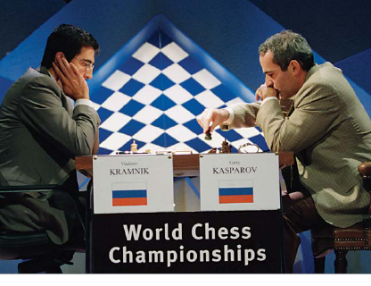
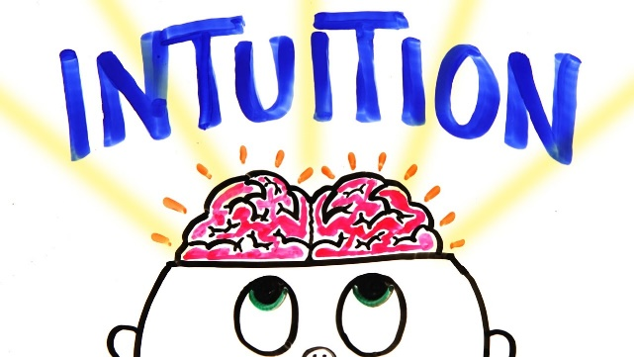
Intuition
Intuitive Decision Making
An unconscious process created out of condensed experience.
Conditions Favoring Intuitive Decision Making
A high level of uncertainty exists
There is little pattern available to draw on
Variables are less scientifically predictable
“Facts” are limited
Analytical data are of little use
Several reasonable alternative solutions exist
Time is limited and pressing for the right decision

Slide 23
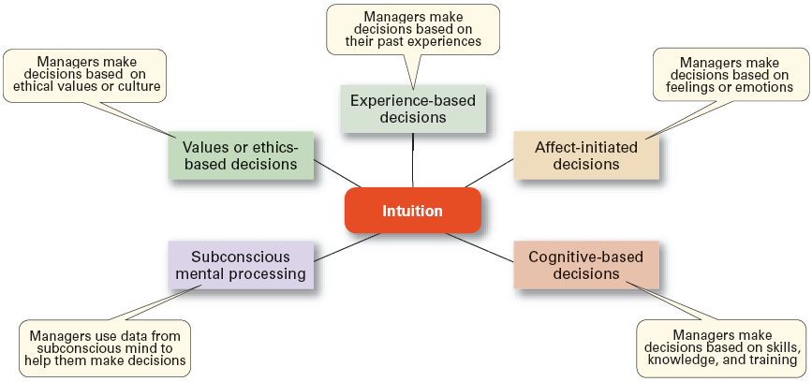
The Role of Intuition
Intuitive decision making
Making decisions on the basis of experience, feelings, and accumulated judgment.
Intuition – quick apprehension of situation based on practice and experience
Notes:
Intuition is the ability to understand something instinctively, without the need for conscious reasoning.
The Role of Intuition
Intuition decision making can complement both rational and bounded rational decision making.
What is intuitional decision making? Its dimensions are as follows:
1. Managers make decisions based on their past experiences: They make decision based on what were the outcomes of their decisions in the past such as failure or success? Now he/she try to make decisions accordingly.
2. Managers make decisions based on feelings or emotions .i.e. managers are human beings so have gut feelings and emotions which play very important role in decision making. The old belief that manager should ignore emotions when making decisions may not be the best advice because a recent study found that individual who experienced intense feelings and emotions when making decisions actually achieved higher decision making performance.
3. Managers make decisions based on skills knowledge and training means the manager’s education, family back-ground, personality and their mental skills also effect when they make decisions.
4. Managers use data from subconscious mind to help them make decisions .One familiar example of the operation of the unconscious is the phenomenon where one fails to immediately solve a given problem and then suddenly has a flash of insight that provides a solution.
5. Managers make decisions based on ethical values or culture. The culture of that country where they are working and making decisions as well as the ethical values of the country something ethical for us may not be ethical for others, their personal strong beliefs values and the culture where they belong, have important role in decision making.

Slide 24
Individual Differences in Decision Making
Personality
Aspects of conscientiousness and escalation of commitment.
Self Esteem High self serving bias
Gender
Women tend to analyze decisions more than men.

Slide 25
Common Biases and Errors in Decision Making
Anchoring Bias
Using early, first received information as the basis for making subsequent judgments.
Availability Heuristic Bias
Using information that is most readily at hand.
Recent
Vivid
Bandwagon Effect
The tendency people have to adopt a certain behavior, style, or attitude simply because everyone else is doing it.

Slide 26
Common Biases and Errors in Decision Making (Cont.)
Representative Bias (Choice Supportive Bias)
Assessing the likelihood of an occurrence by trying to match it with a preexisting category using only the facts that support our decision.
“Mixing apples with oranges”
Confirmation Bias
Using only the facts that support our decision. Confirming what we already know
Ostrich Bias
Ignoring the negative information – Smokers ignoring effects of cigarette
Watch Video: https://www.youtube.com/watch?v=wEwGBIr_RIw

Slide 27
Common Biases and Errors in Decision Making (Cont.)
Overconfidence Bias
Believing too much in our own ability to make good decisions.
Escalation of Commitment
Despite setbacks, you continue projects which add up more resource time and money (e.g orange line Lahore, nuclear power plant new york) .
Randomness Error
Creating meaning out of random events
Notes:
Escalation of Commitment Defined
In 1966 a project to build a nuclear power plant in Long Island, New York began. It was anticipated it would cost $75 million and be able to generate power for the growing city by 1973. No one anticipated the pushback from local citizens, and because of that resistance the project wasn't completed until 1986 at a cost of more than $6 billion. In the end, the plant never opened.
Why was management at the Long Island Lighting Company so willing to stick to their project even as the cost skyrocketed and the completion date was pushed back by more than two decades? The answer is escalation of commitment.
Escalation of commitment happens when someone continues to dedicate resources, including time and money, to a failing course of action. Like management at the Long Island Lighting Company, it is sometimes easy to feel that if we give up on a course of action, then we lose the money and time already committed to that decision.

Slide 28
Exercise for Decision Making Read each sample decision and decide whether it is Type A (rational) or Type B (intuitive):
A
B
A
A
B
B
Getting yourself from your place of work to a meeting in another specific location.
Being dropped anywhere in the country, without knowing where, with PKR 1000, and the task of getting home. Imagine yourself standing in a city surrounded by a light fog.
Choosing the means of communicating some minor redundancies in the company, given a 48-hour deadline and a partly unionized workforce.
Selecting an incentive payment scheme for a work area where workloads are extremely variable and where payment has previously been on a flat rate.
Deciding how to approach your boss about a favour you want and knowing that he or she can be very moody and changeable.
Deciding how to run a particular appraisal interview.

Slide 29
Ethics in Decision Making
Ethical Decision Criteria
Utilitarianism
Seeking the greatest good for the greatest number.
Rights
Respecting and protecting basic rights of individuals such as whistleblowers.
Justice
Imposing and enforcing rules fairly and impartially.

